Slide 1

MindWallet
Context-Aware Personal Finance & Decision Support Platform
Making personal finance simple, accessible, and intuitive.
Course Project Presentation — HCI & Inclusive UI/UX Design
Course: User Interface & UX Design
Faculty: Jeevitha P
Review Stage: 0th Review (Initial Proposal)

Slide 2


Abstract
Project Scope & Objectives
Core Philosophy & Approach
MindWallet is a web-based personal finance application designed to streamline expense management, budget tracking, and subscription monitoring.
"Money Made Simple."
Rather than presenting complex statistical logs, MindWallet proposes simplified dashboards, progressive information disclosure, and proactive decision support tools like purchase simulators.
The system focuses on bridging digital accessibility gaps by adopting human-computer interaction (HCI) best practices and WCAG 2.2 AA standards.

Slide 3






Problem Statement (Existing System)
Cognitive Overload
Passive Expense Tracking
Lack of Inclusive Design
Existing mobile & web finance tools present crowded dashboards with heavy financial jargon, causing high cognitive friction for novice users.
Current platforms act purely as historical logs without offering guided financial decision support prior to making purchases.
Limited assistance for elderly users, individuals with visual or motor impairments, and users with low digital literacy.

Slide 4

Proposed System & Novelty
Accessibility-First UI Framework: Built-in Senior Mode, high-contrast themes, scalable typography, and full keyboard/screen-reader compliance.
Key Differentiator
Integrates HCI principles directly into personal finance—converting raw data into clear, accessible visual cues.
Interactive Purchase Simulator: Pre-evaluates purchase impact against live budgets to assist spending decisions.
Financial Health Index: A simplified metric evaluating liquidity, budget adherence, and savings performance.
Target Inclusion
Equally optimized for tech-savvy students and elderly or low digital-literacy users.
Reduced Cognitive Load: Plain-language guidance, contextual tooltips, and step-by-step form wizards.

Slide 5
Core System Modules
1. Management Modules
2. Analytics & Decision Support
3. Accessibility Engine
• Income & Expense Tracker
• Subscription Manager
• Budget Planner
• Savings Goals
• Financial Health Score
• Purchase Simulator
• Spending Analytics
• Monthly PDF Reports
• Senior Mode Toggle
• Font & Contrast Controller
• ARIA Screen Reader Labels
• Guided Walkthroughs

Slide 6
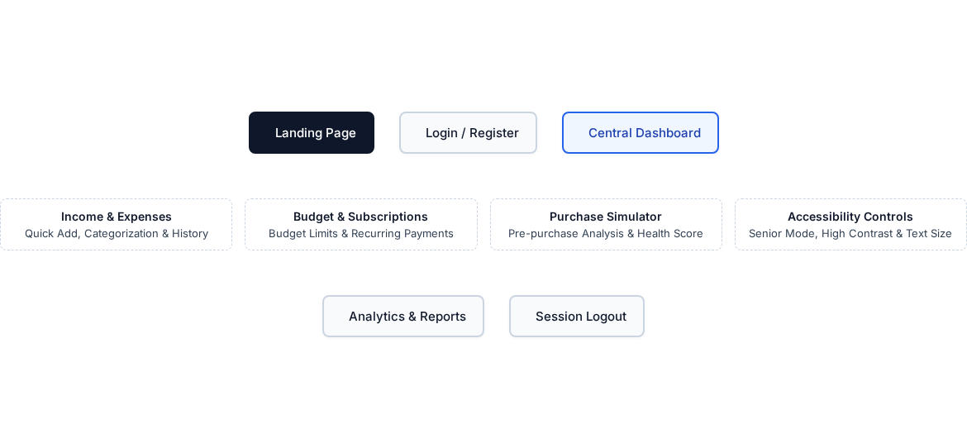
Interaction Design Flow & Screen Navigation

Slide 7
Competitor Analysis
Feature / Capability | YNAB / Monarch | Rocket Money | MindWallet (Proposed)
Expense Tracking | Detailed | Detailed | Simplified & Guided
Accessibility (WCAG 2.2) | Partial | Partial | Accessibility-First
Purchase Simulator | Absent | Absent | Integrated Tool
Senior / Inclusive Mode | None | None | Dedicated Option

Slide 8



Project Roadmap & Implementation Flow
2. Conceptualize
4. Develop
Metaphors & UI wireframes
HTML/CSS/JS frontend
1. Requirement
3. Prototype
5. Evaluation
HCI goals & user research
Figma UI/UX design
WCAG 2.2 & Usability test

Slide 9



Team Responsibilities & Work Distribution
Member 1
Member 2
Member 3
UX Research & Documentation
UI/UX Design & Prototyping
Frontend Development & Testing
• User Personas & Journey Maps
• Information Architecture
• Documentation & Review Slides
• Figma Wireframes & Systems
• Accessibility & Senior Mode UI
• Interactive Prototypes
• HTML5/CSS3/JavaScript UI
• Module Integration
• Usability & WCAG Testing

Slide 10
Thank You
MindWallet — Money Made Simple

